Slide 1
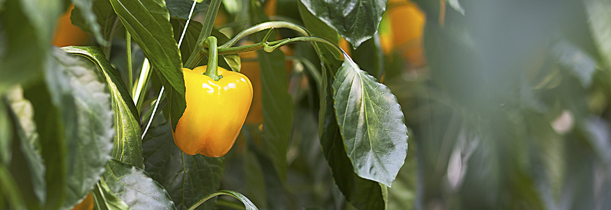
Smart Farming 청년농업
SmartFarm in korea
태곡 농원 (TG farm, Gyuseok Roh)

Slide 2
Smart Farming 청년농업
Contents
Background
Smart farm – Why it is necessary
How we use it

Slide 3
STEP
1
Background
Smart Farming 청년농업
노 규 석 (Gyuseok Roh)
CEO TG farm
2018,9 MAFRA. smartfarm leading company
2014 Joined farming business
Business & IT (BSc) : University College London

Slide 4
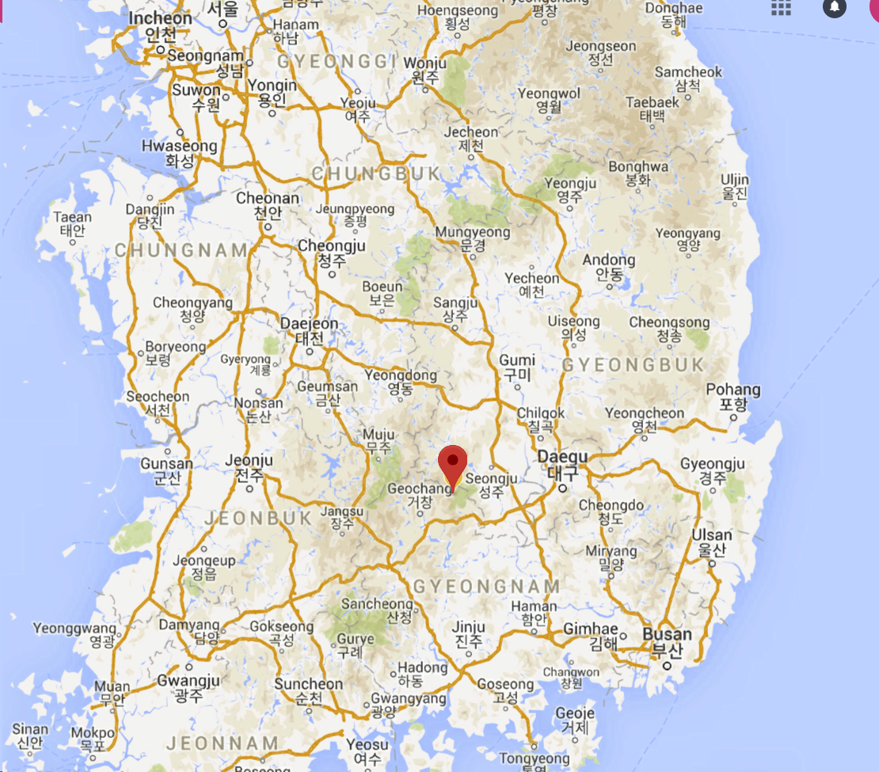
STEP
1
Background
Smart Farming 청년농업
태곡 농원(TG farm)
Located in Highland (800~900m)
Winter -20℃, summer 16~30℃
Very cold but good cool summer.
(Good crop condition in summer)
Size - 2.5ha Green house 0.7ha Apple
consist 3 greenhouses farm 1,2 : tomato,
farm 3 : paprika Employees 15 people, supplier (E mart)
Crops – paprika, beef tomato, cucumber

Slide 5
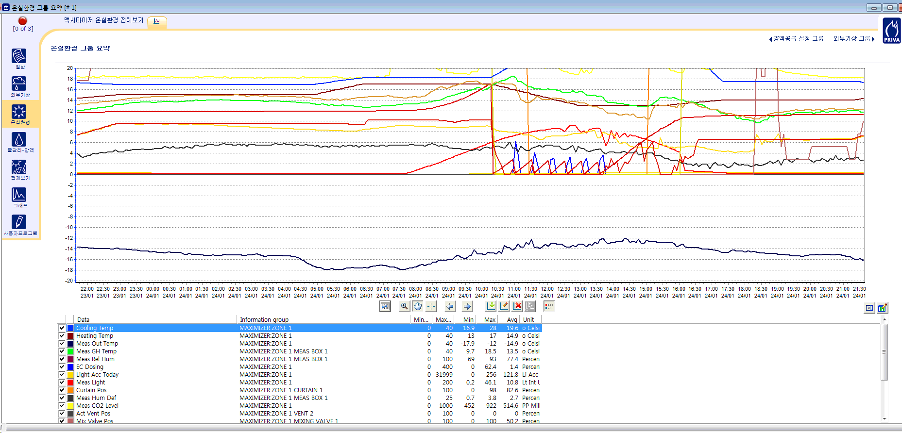
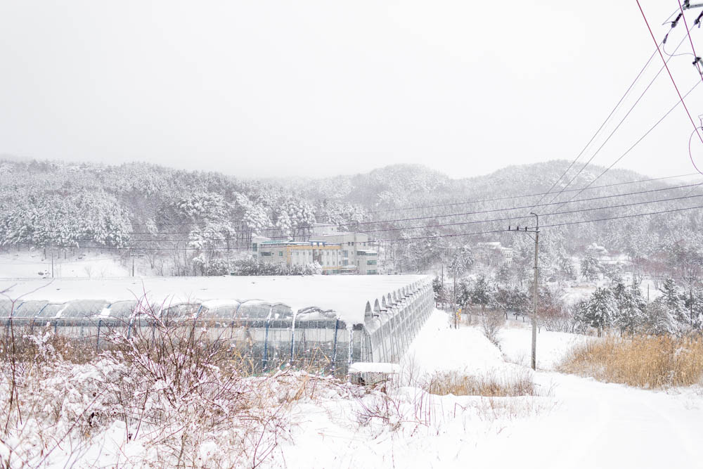
STEP
1
Background
Smart Farming 청년농업
Strong characteristic : Highland (900m mountain)
Light penetrance is important but have to consider heating
Very difficult condition in winter
-18도

Slide 6
STEP
1
Background - Problems
Smart Farming 청년농업
Problems
Costs goes up every year (electric bill, labour costs, fertilizers so on), but market price
Lack of Human resource (I have to cover almost everything)
Lack of experience and knowledge
Conflict with existing farmers - mostly generation difference problem

Slide 7
STEP
2
Smart farm (Why it is necessary)
Smart Farming 청년농업
Solutions with smart farm
standard
data that I can actually use in farming
data become useful information
costs, production management

Slide 8
STEP
2
Smart farm (Why it is necessary)
Smart Farming 청년농업
standard!
- almost everything (greenhouse style, equipment, plant variety..)
- this standard gives a huge advantage because,
- easy to share information, e.g, education for new farmers,
- we use standard data (objective data) like RH, in temp, out temp,
crop temp, root environment (EC, PH, so on) almost everything
So specialists can help us easily

Slide 9
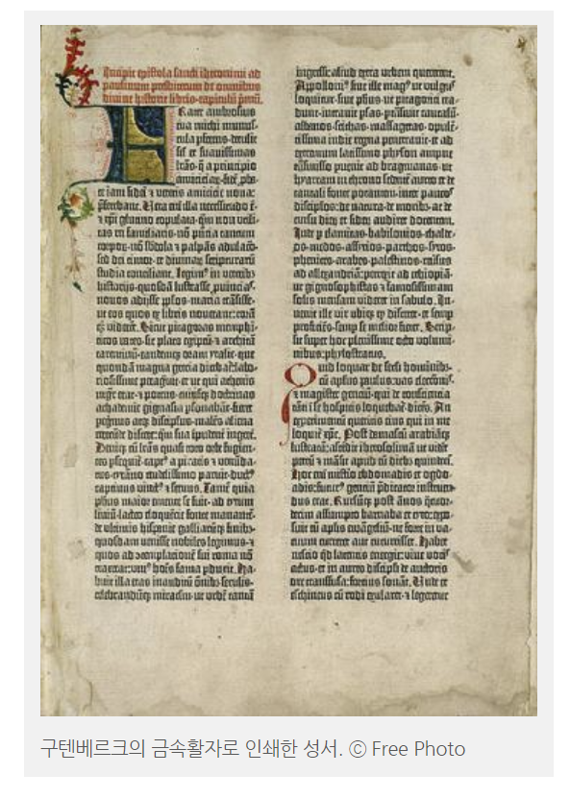
STEP
2
Smart farm (Why it is necessary)
Smart Farming 청년농업
Data in farming. Revolution
Johannes Gutenberg
German blacksmith who introduced printing to Europe (mechanical movable type)
Brought printing revolution
Regarded contribution mild stone of the second millennium, access to modern period of human history

Slide 10
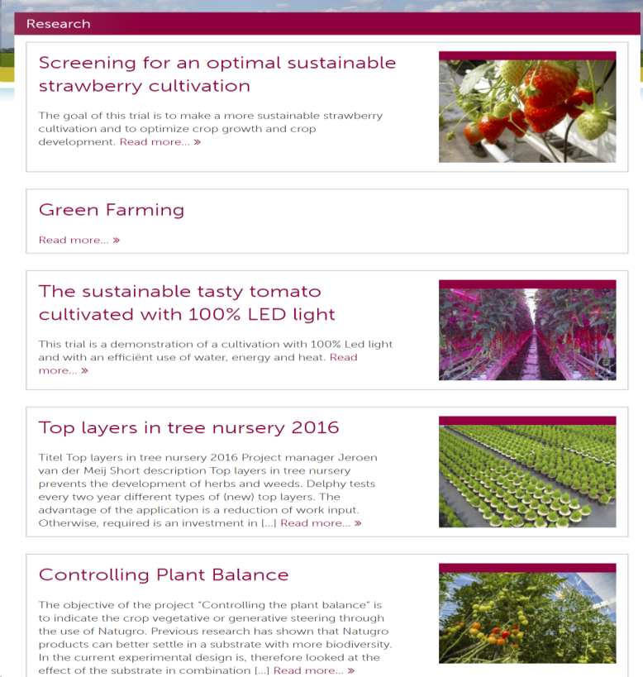
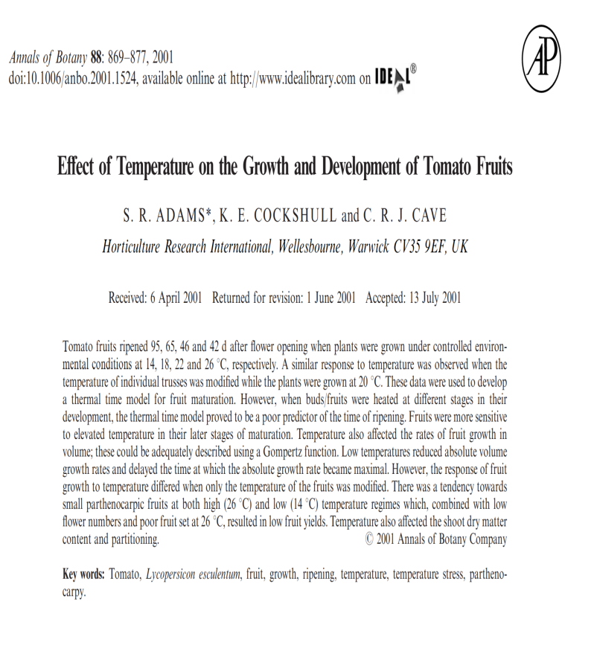
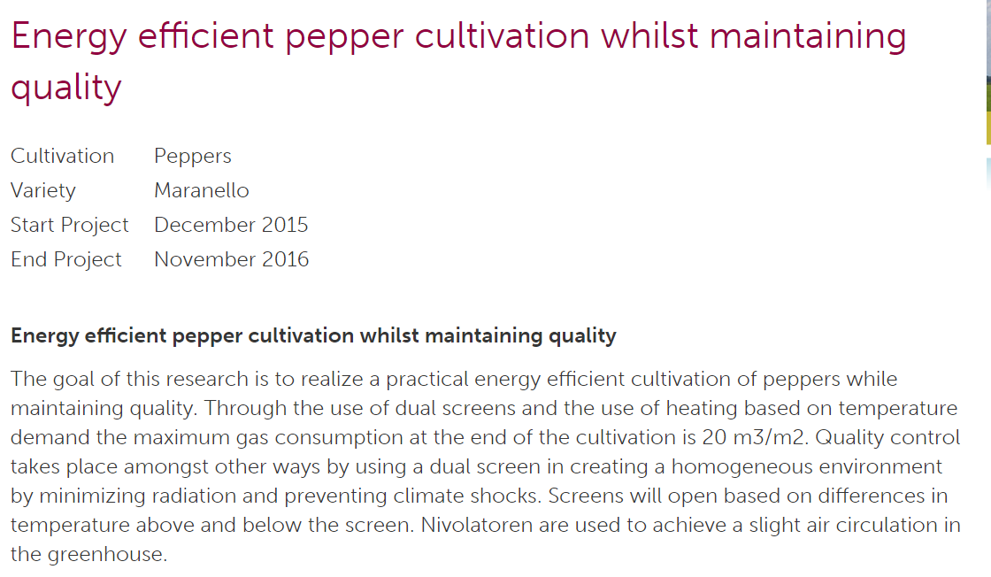
STEP
2
Smart farm (Why it is necessary)
Smart Farming 청년농업
Researches that farmers can actually use
E.g. Researches : maximising energy efficiency while keeping quality

Slide 11
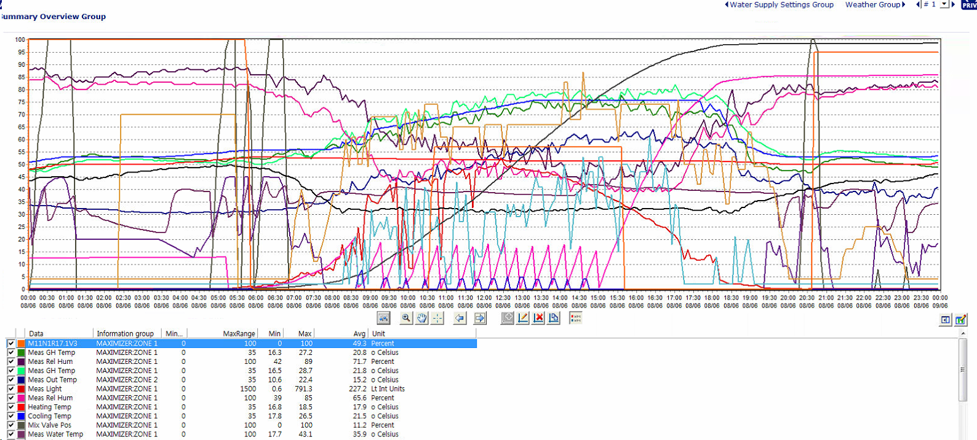
STEP
2
Smart farm (Why it is necessary)
Smart Farming 청년농업
Pre night

Slide 12
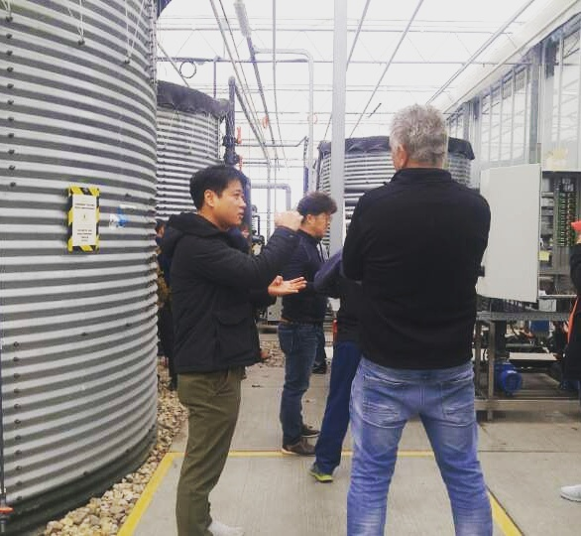
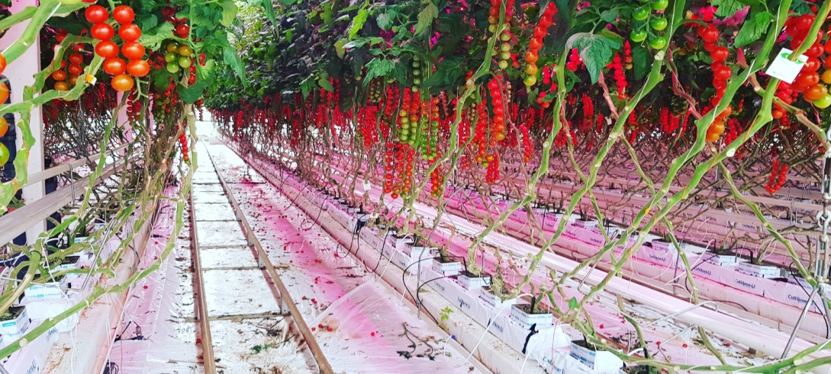
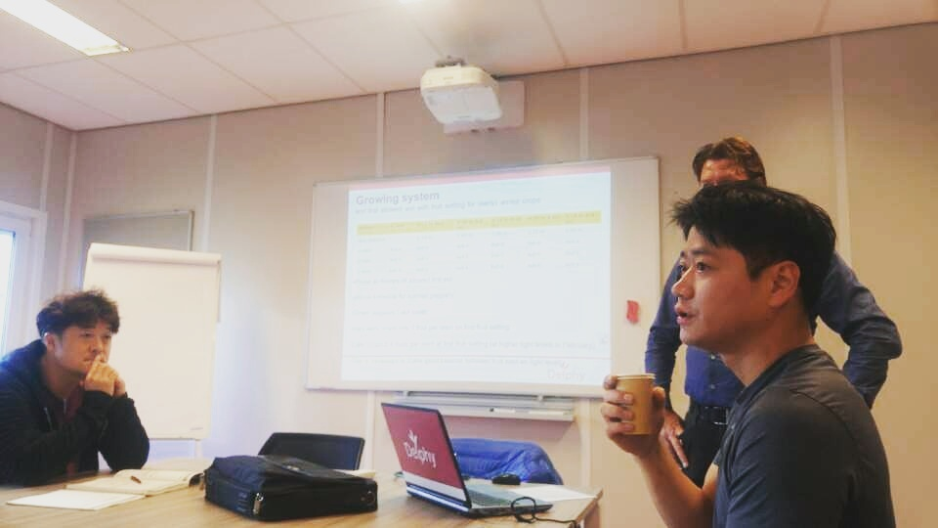
STEP
2
Smart Farming 청년농업

Slide 13
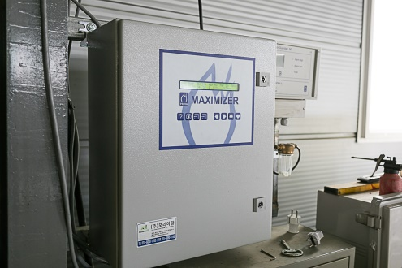
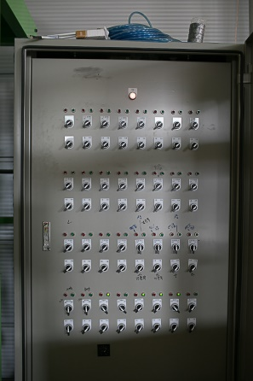
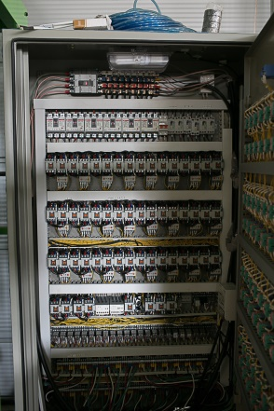
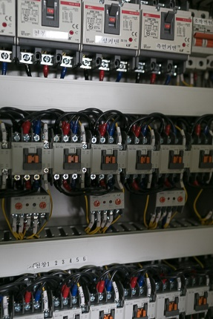
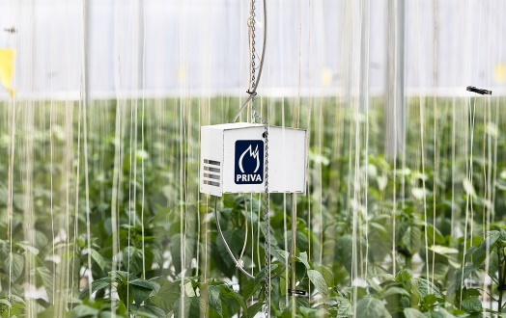
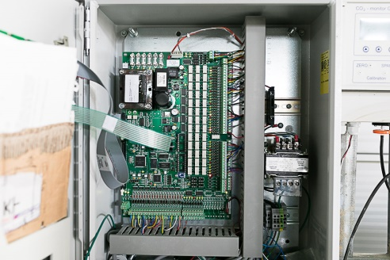
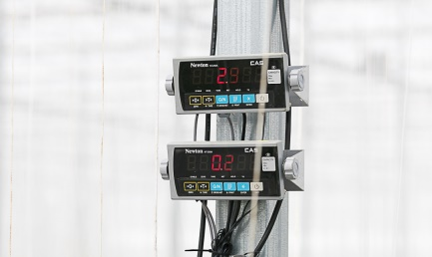
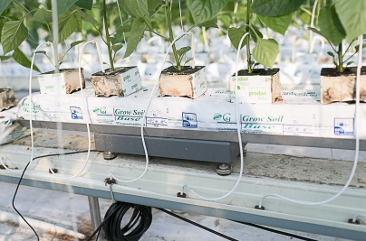
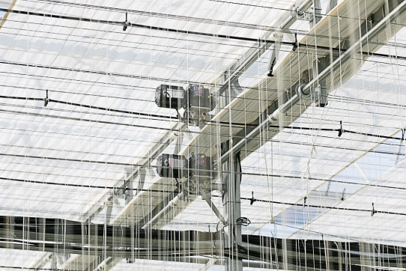
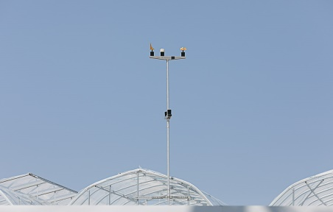
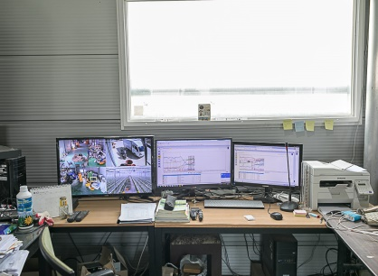
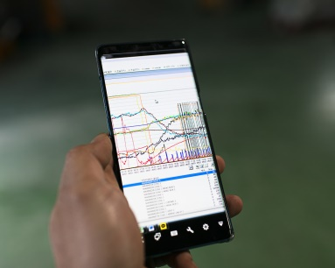
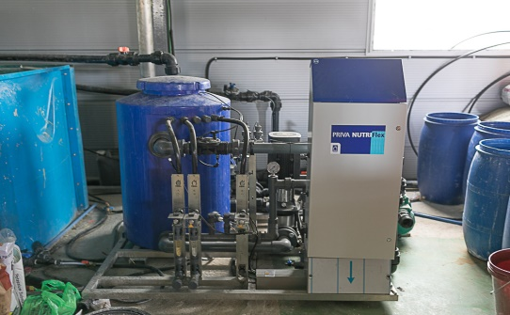
STEP
3
Smart farm (Why it is necessary)
Smart Farming 청년농업
Main computer
Main panel
sensor
equipment
User Interface (UI)

Slide 14
STEP
3
How we use it
Smart Farming 청년농업
Pre night

Slide 15
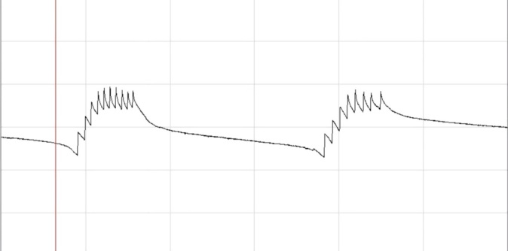
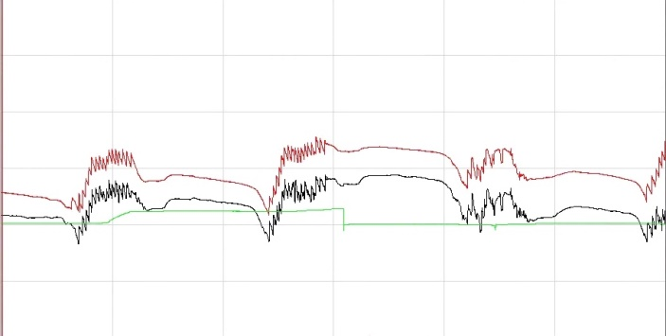
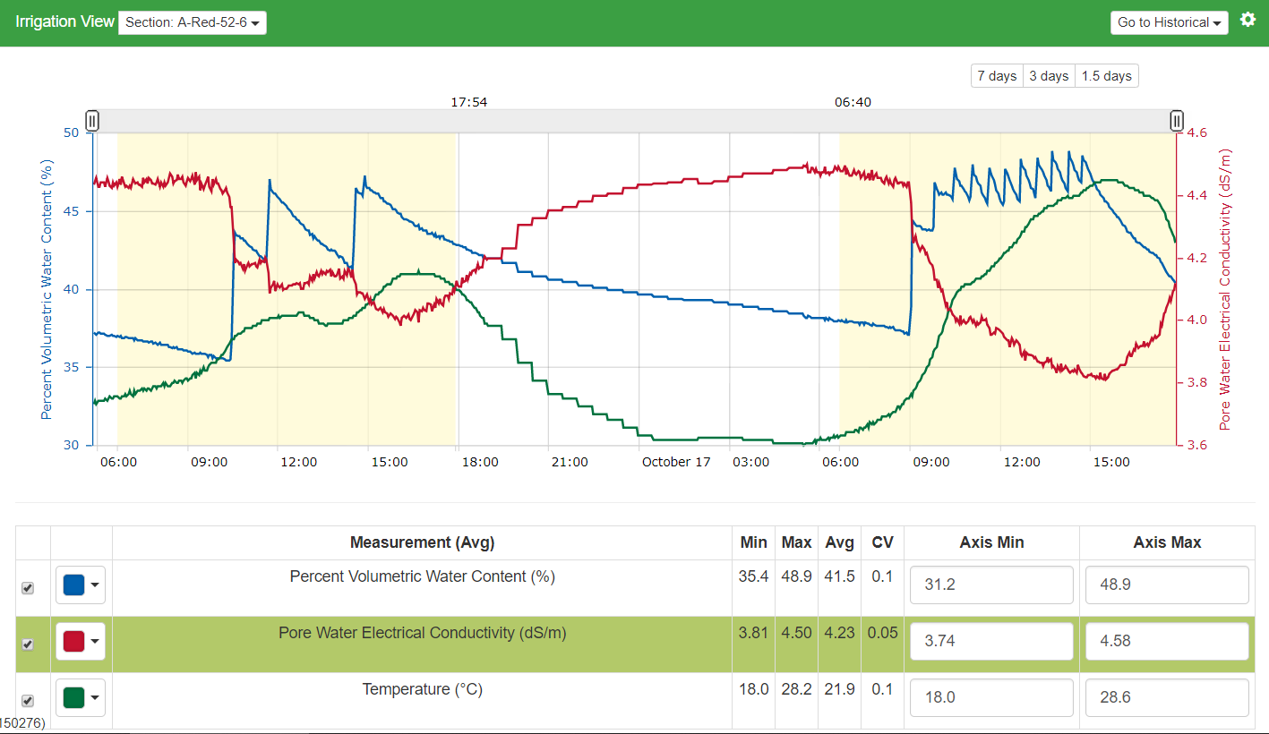
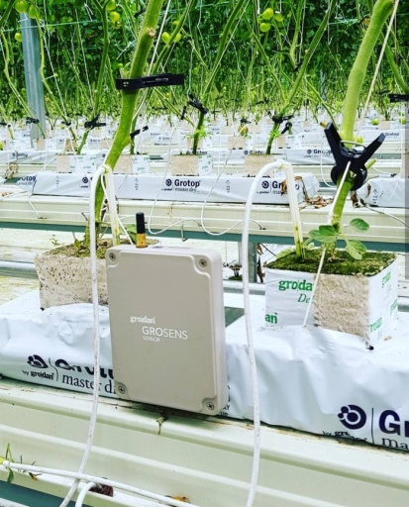
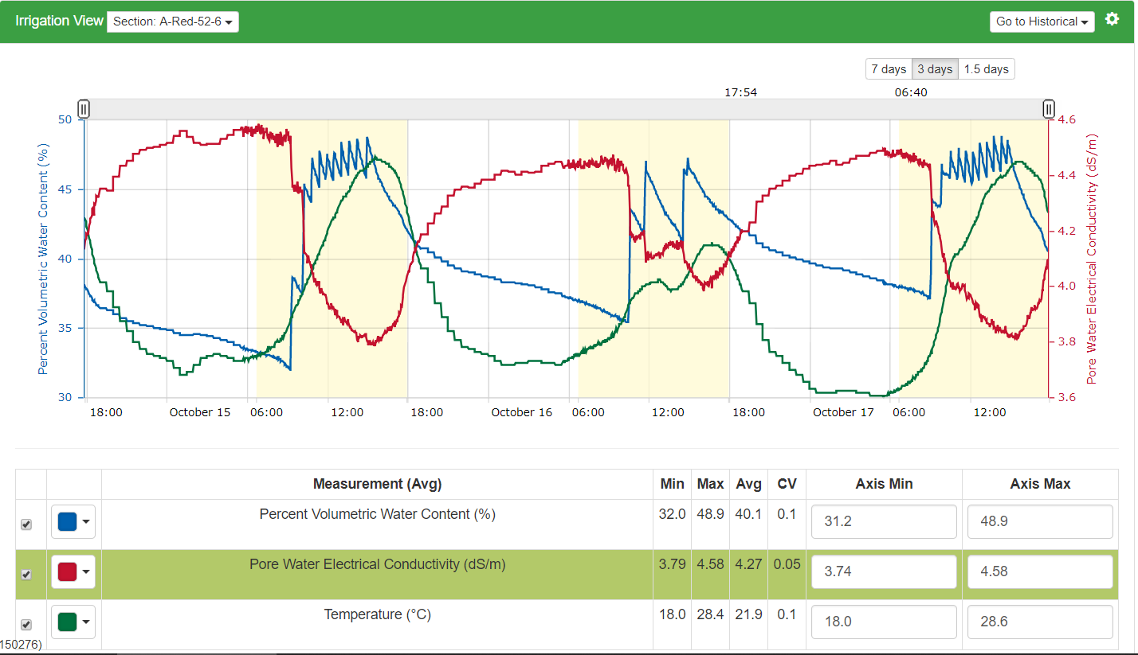
STEP
3
How we use it
Smart Farming 청년농업
Slab weight monitoring
Slab sensor monitoring

Slide 16
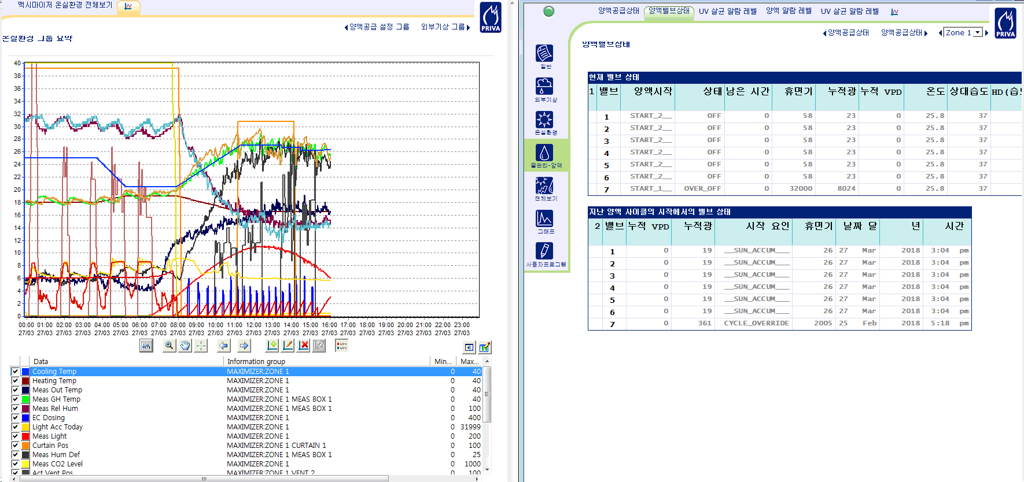
STEP
3
How we use it (monitoring)
Smart Farming 청년농업

Slide 17
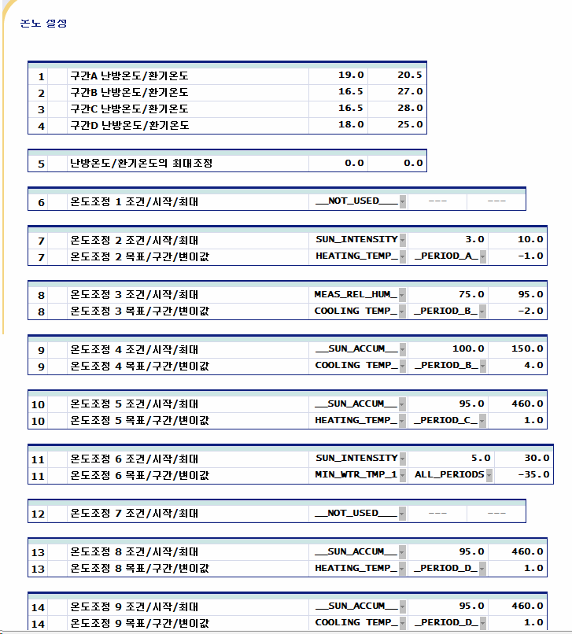
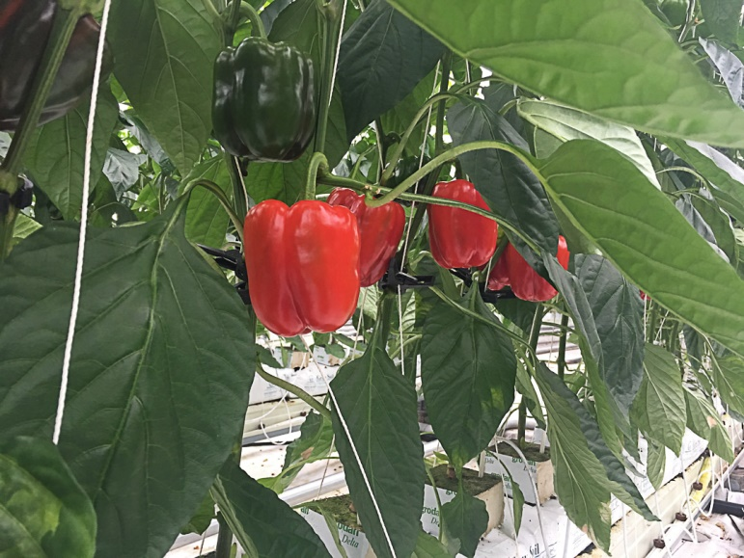
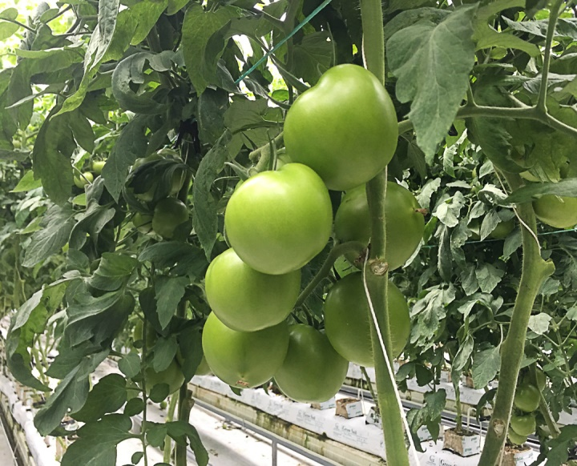
STEP
3
How we use it
Smart Farming 청년농업
데이터의 활용
작물관찰 생식,영양 ? 환경 셋팅 확인 반복
Observation analyse setting confirm. repeat
We can always discuss with consultants effectively
with objective data
>
>
>
>
▶

Slide 18
STEP
3
How we use it
Smart Farming 청년농업
Cost and revenue analysis
We have good information for best crop control but often we cant use it
Costs, espeically heating cost (winter ; US $20k /month per ha ), labour
Have to consider market price and use computer to control the cost
We are trying to find the most efficient way to reduce costs every year.

Slide 19
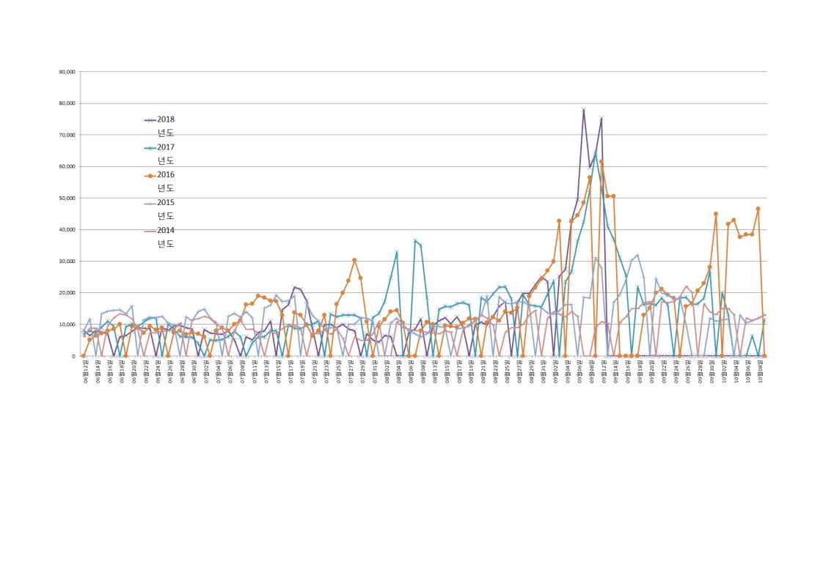
STEP
3
How we use it
Smart Farming 청년농업
Price of tomato (5kg box) in Korea during the last 5 years
July
August
September
October

Slide 20
STEP
3
How we use it
Smart Farming 청년농업
We control temp and RH to control ripening and size, pest, disease etc
There are plenty of studies that we can refer
Eg,
flower -> tomato ; 24 hour temp comparison
14 temp -> 95days
18 temp -> 65days
22 temp -> 46days
26 temp -> 42days
Ref: S. R. ADAMS *, K. E. COCKSHULL and C. R. J. CAVE (2001) Horticulture Research International, Annals of Botany 88: 869±877.

Slide 21
STEP
3
How we use it
Smart Farming 청년농업
Night RH 80%
horizontal curtain 30%
opened
Heat costs up, good for crops
Night RH 90%
Horizontal curtain 100%
closed cost down, bad for
crops

Slide 22
Smart Farming 청년농업
Thank you
노규석 (Gyuseok Roh)
zitensha@gmail.com
010-3108-7464
경남 합천군 가야면 치인4길 250
태곡 농원 (TG farm)

